Slide 1
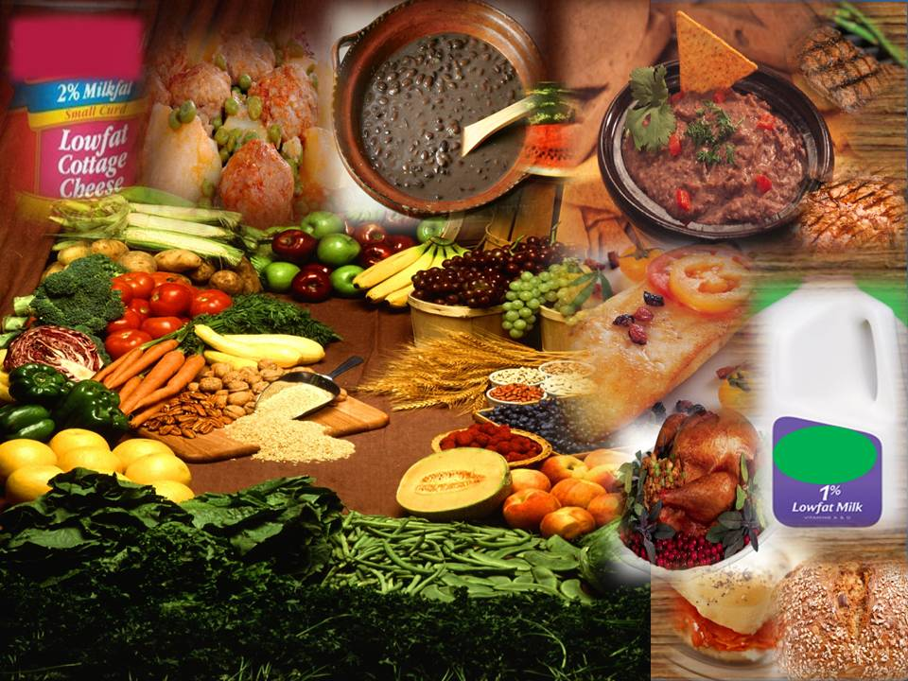
Research report: how dry beans keep Americans healthy
Joanne Slavin, PhD, RD
Professor
University of Minnesota
November 19, 2015
Notes:
1

Slide 2
Today’s Talk
Describe the Dietary Guidelines Advisory Committee (DGAC) process and questions for “Dried beans and peas”
Summarize the 2010 Dietary Guidelines for Americans for this food group.
Give perspective on how beans, pulses, and legumes fit on MyPlate

Slide 3
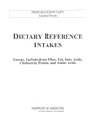
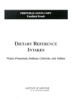
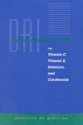
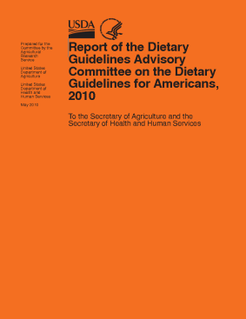

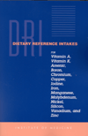
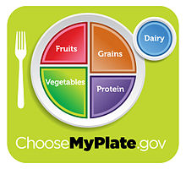
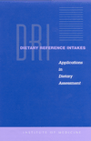
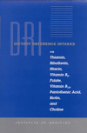
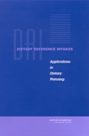
From the Science to Me
The Science Policy Public ME

Slide 4
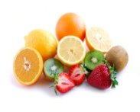
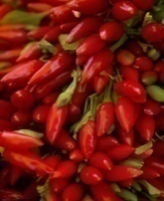
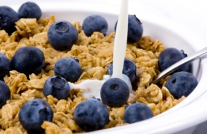
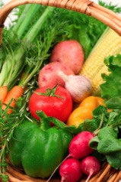


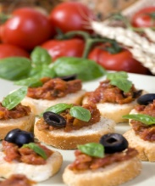
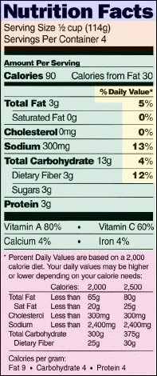




Development of Dietary Guidelines Policy
Dietary Guidelines for Americans, 2010
(TBD)
U.S. Department of Agriculture
U.S. Department of Health and Human Services
www.dietaryguidelines.gov
DGAC Charter
The
New
“Pyramid”
DGAC Public Meetings: Review of the Science
DGAC Advisory Report submitted to the Secretaries of USDA & HHS
USDA & HHS write the Policy Document
DGAC is chartered
DG’s implemented through Federal programs
Public comments encouraged/collected
Evidence-based Methodology Used to Review the Science

Slide 5

Evidence Analysis Methodology
Rigorous
Minimizes bias
Transparent
Accessible to stakeholders and consumers
Defines state of the science
Foundation for updates
Answers precise questions • Illuminates research gaps
Notes:
NEL benefits dovetail nicely with our obligations related to the Data Quality Act providing a methodology which is:
Rigorous – A protocol-driven, openly documented, systematic review is done based upon a pre-defined criteria for searching and sorting the scientific literature; critically appraisal of methodological rigor of included studies; extracting, summarizing, and synthesizing the evidence; and grading the quality of the body of evidence.
Minimizes bias - bias is minimize by the comprehensiveness and reproducibility of the search for and selection of articles for review
Transparent - Meticulous methods and electronic tools are used to describe and document the literature search (e.g., # studies identified), assessment of methodological quality of included studies, and evaluation of the overall strength
of that body of evidence. Open documentation of the process makes it possible to trace or replicate the review.
Accessible - NEL’s web-based platform is an easily accessible science-based resource for policymakers, stakeholders, and consumers
Defines the state of the science - by synthesizing the research available to answer very precise questions. It is ideal to inform public health guidelines, policy and research agendas.
Foundation for updates – this is particularly helpful for ongoing support of the Dietary Guidelines and ongoing support of USDA nutrition related programs

Slide 6
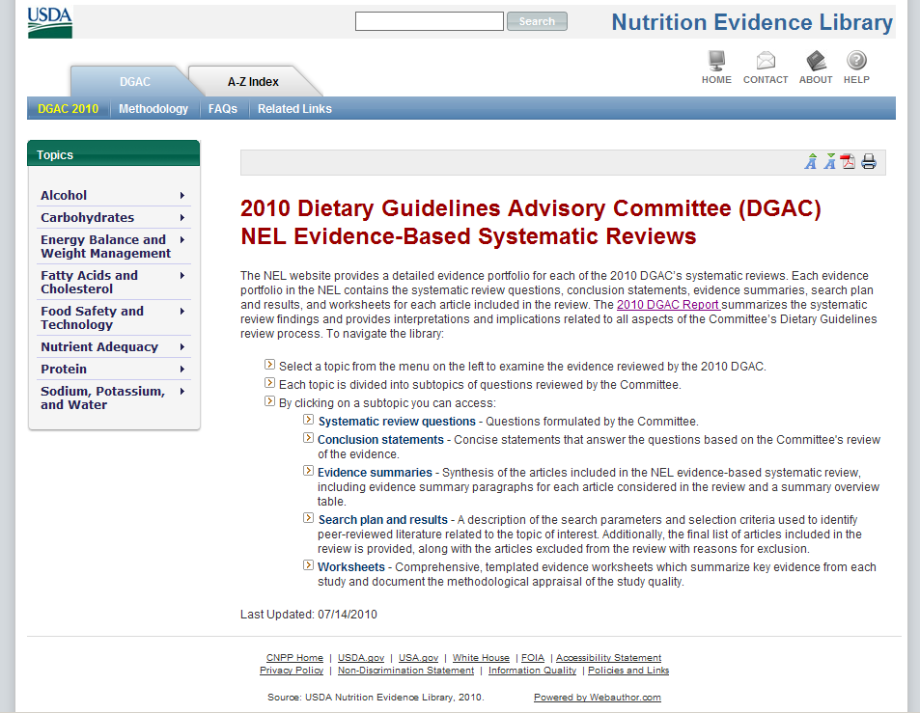
Indexing/Search
Topics
Available at:
www.NutritionEvidenceLibrary.gov
Notes:
This is a screen shot of the Nutrition Evidence Library. I have entered the site and clicked on the DGAC tab at the top, which opens the site to the Dietary Guideline project.
Topics are listed on the left hand side and the content is organized as it is found in the chapter. An alternate way of searching the site is to use the A-Z index at the top to find a topic for which you are looking. The search box at the top also works well for identifying all the questions related to a particular topic. The page also describes the type of documents found in the NEL including:
Systematic review questions
Research recommendations
Conclusion statements
Evidence summaries
Search and sort plans
Evidence worksheets

Slide 7
Hierarchy of Evidence
Stronger Evidence
RCT
Double Blinded
Clinical Study
Prospective, cohort study
Cross-sectional study
Case-control study
Case Report
Expert Opinion
Weaker Evidence

Slide 8
Dry Beans and Peas
What is the relationship between the intake of dry beans and peas and selected health outcomes?
Notes:
8

Slide 9
Dry Beans and Peas - Conclusions
Limited evidence exists to establish a clear relationship between intake of dry beans and peas and body weight.
Limited evidence suggests that dry beans and peas have unique abilities to lower serum lipids; most of the lipid lowering seen in studies is related to the soluble fiber content of these products.
Limited evidence is available to determine a relationship between the intake of dry beans and peas and type 2 diabetes.
Notes:
9

Slide 10
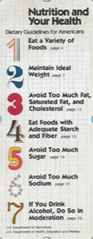
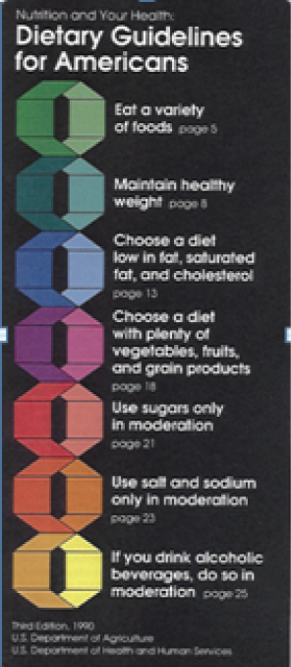
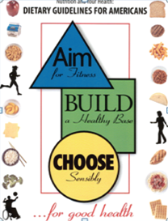

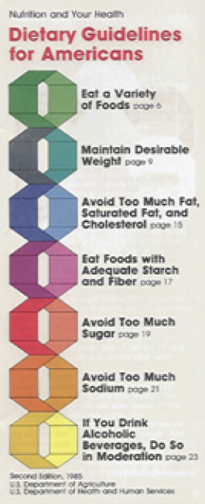
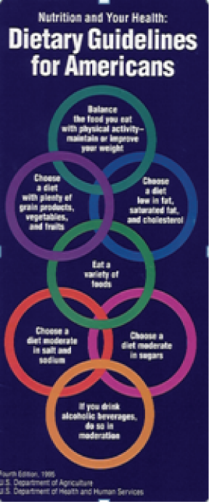
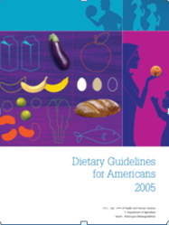
Dietary Guidelines for Americans 1980 - 2010
2000
2010
1980
1990
1985
1995
2005
Notes:
10
Since 1894, the Department of Agriculture has developed and issued food and dietary guidance for the American public. The goal of DGs is to define a healthy diet; provide healthy options for dietary patterns; promote healthy food choices; and increase public awareness of the relationship between diet and health.
Here you see all the Guidelines that have been published since 1980. They evolved over time to make better use of nutrition science and to better communicate the science. The first four versions of the DGs were small brochures that aimed at consumers. The information came mainly from the experts appointed to the Dietary Guidelines Advisory Committees. The Committee members drew from their collective knowledge of nutrition research.
The 2000 version was a 39-page consumer and a policy document combined. This reflected a move by the Government toward helping nutrition educators and dietitians, who apply dietary guidance in their work, to better understand the science behind the consumer material.
In 2005, a 70-page booklet served solely as a policy document and represented a departure by acknowledging that nutrition educators, nutritionists, and policymakers all needed the science—in plain language—that would serve as the foundation for their work. A search and review of the scientific literature served as the basis for these guidelines.
The 2010 document again is a policy document intended for policymakers to design and carry out nutrition-related programs; and for nutrition educators and health professionals, who develop nutrition curricula, teaching tools, and advice for consumers. However, for 2010, a robust, systematic approach was used to organize and evaluate the science on which the Guidelines are based. It assessed the quality of research using evidence-based reviews, which were conducted by the staff of USDA’s new Nutrition Evidence Library. The scientific recommendations on which the policy rests were derived from an objective analysis of the preponderance and quality of published research.

Slide 11
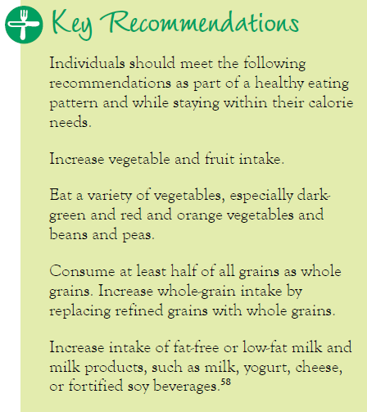
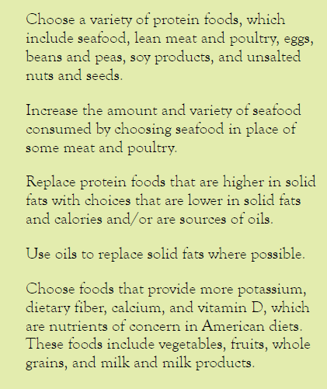

Ch 4: Foods and Nutrients to Increase
Notes:
Chapter 4 Key Recommendations for everyone age 2 and older
11

Slide 12
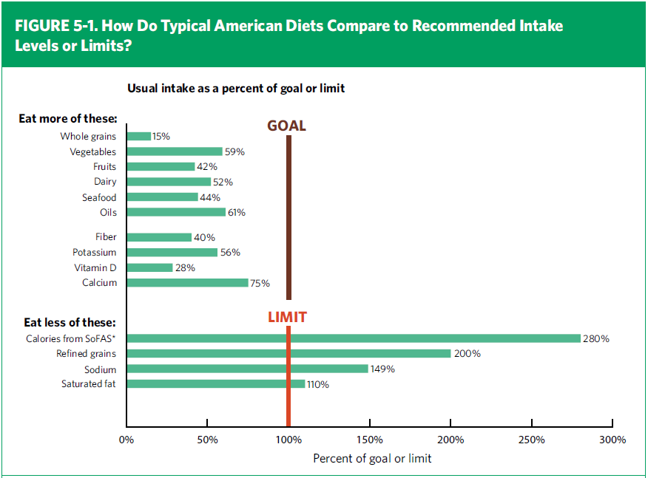
Comparison of Consumption to Recommendations
Notes:
This chart shows how the average American diet compares to recommendations found in the 2010 Dietary Guidelines. Vegetables and fruits, along with whole grains, dairy products, seafood, and oils are consumed below recommended amounts. Nutrients of concern are fiber, potassium, calcium, and vitamin D.
The excessive amounts consumed of solid fats and added sugars, refined grains, and sodium are clearly shown in comparison to recommended limits.
12

Slide 13
Key Consumer Messages
Balancing Calories
  Enjoy your food, but eat less.
  Avoid oversized portions.
Foods to Increase
  Make half your plate fruits and vegetables.
  Make at least half your grains whole grains.
  Switch to fat-free or low-fat (1%) milk.
Foods to Reduce
  Compare sodium in foods like soup, bread, and frozen meals ― and choose the foods with lower numbers.
  Drink water instead of sugary drinks.
Notes:
These track with the Dietary Guidelines. Will address in more detail “Make half your plate fruits and vegetables.”

Slide 14
Vegetable Group
Any vegetable or 100% vegetable juice counts as a member of the Vegetable Group.
Vegetables may be raw or cooked; fresh, frozen, canned, or dried/dehydrated; and may be whole, cut-up, or mashed.
Vegetables are organized into 5 subgroups, based on their nutrient content
  Dark green vegetables
  Red and orange vegetables
  Starchy vegetables
  Other vegetables
  Beans and peas
Notes:
Joanne – need to talk people through the beans and peas – Beans and peas count under Protein group until oz-equiv goal is met, then count the remainder under Vegetable group.

Slide 15
Beans and peas are unique foods
Beans and peas are the mature forms of legumes – include kidney beans, pinto beans, black beans, garbanzo beans (chickpeas), lima beans, black-eyed peas, split peas, and lentils
B/P excellent sources of protein – provide iron and zinc, similar to seafood, meat, and poultry – excellent sources of dietary fiber and nutrients such as potassium and folate

Slide 16
Beans and peas are unique foods
Beans and peas may be considered both as a vegetable and as a protein food. Individuals can count beans and peas as either a vegetable or a protein food
Green peas and green beans are not considered to be “beans and peas.” Green peas are “starchy vegetables” and green beans are grouped with “other vegetables”
  P 35 from Dietary Guidelines for Americans 2010

Slide 17
USDA MyPlate
How Many Vegetables Are Needed Weekly?
 |  | Dark green vegetables | Red and orange vegetables | Beans and peas | Starchy vegetables | Other vegetables
 | AGE IN YEARS | CUPS PER WEEK
Children | 2–3 | ½ | 2½ | ½ | 2 | 1½
 | 4–8 | 1 | 3 | ½ | 3½ | 2½
Girls | 9–13 | 1½ | 4 | 1 | 4 | 3½
 | 14–18 | 1½ | 5½ | 1½ | 5 | 4
Boys | 9–13 | 1½ | 5½ | 1½ | 5 | 4
 | 14–18 | 2 | 6 | 2 | 6 | 5
Women | 19–30 | 1½ | 5½ | 1½ | 5 | 4
 | 31–50 | 1½ | 5½ | 1½ | 5 | 4
 | 51+ | 1½ | 4 | 1 | 4 | 3½
Men | 19–30 | 2 | 6 | 2 | 6 | 5
 | 31–50 | 2 | 6 | 2 | 6 | 5
 | 51+ | 1½ | 5½ | 1½ | 5 | 4
Notes:
Don’t have time to show for the fruit group – and the fruit group does not have subgroups. But I think it’s important to take a look at the vegetable group in more detail because of all the subgroups. Note that each group is recommended in significant amounts. All these subgroups are important because each one contributes different nutrients. And it’s also important to notice that amounts recommended vary by age and gender.

Slide 18
Actual intake of beans/peas in NHANES dataset
Order ranking from 98 categories – beans/peas are infrequently consumed
  Refried beans
  Pinto beans
  Pork and beans
  Baked beans
  Black beans
    White bean, lima bean, bean dip, hummus, cowpeas, chick peas, bean soup, lentil soup

Slide 19
Sources of Protein in the Diet
Protein deficiency is rare in the United States.
In the US, about two-thirds of dietary protein comes from meat, poultry, seafood, eggs and dairy products.
Most of the world relies on plant proteins from grains and vegetables.
As a country’s economy improves, the proportion of animal foods in the diet tends to increase.
Notes:
19

Slide 20
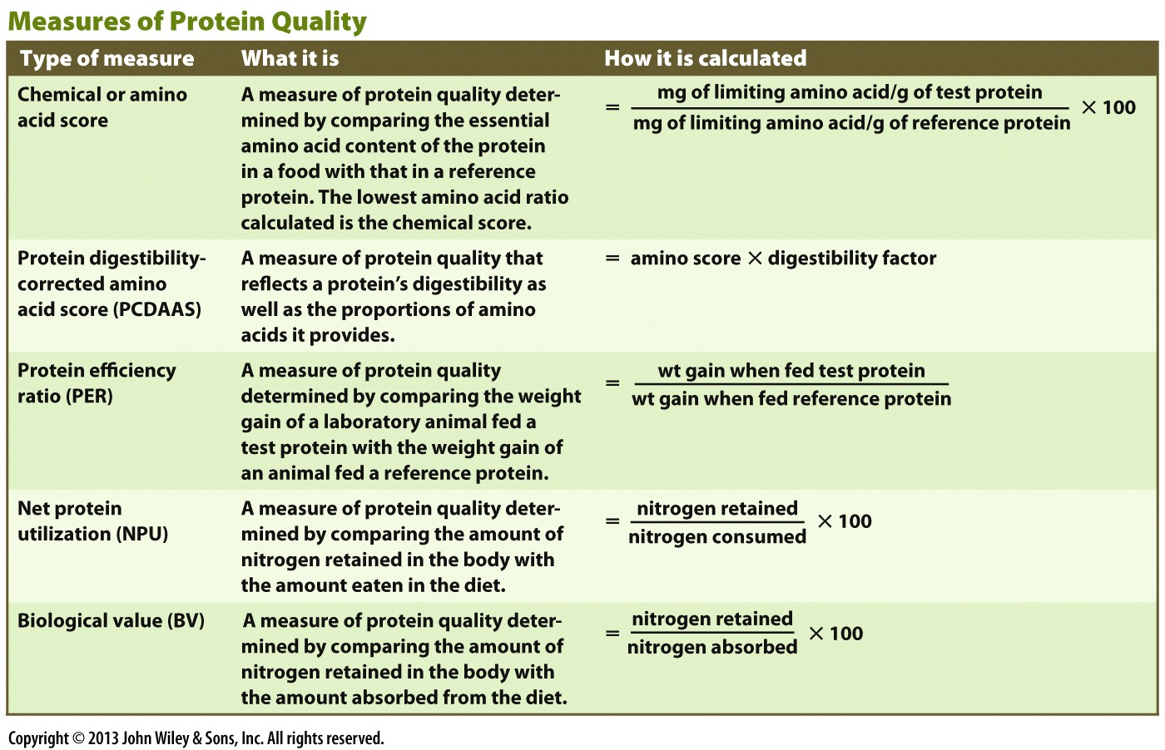
Considering Protein Quality
Notes:
20

Slide 21
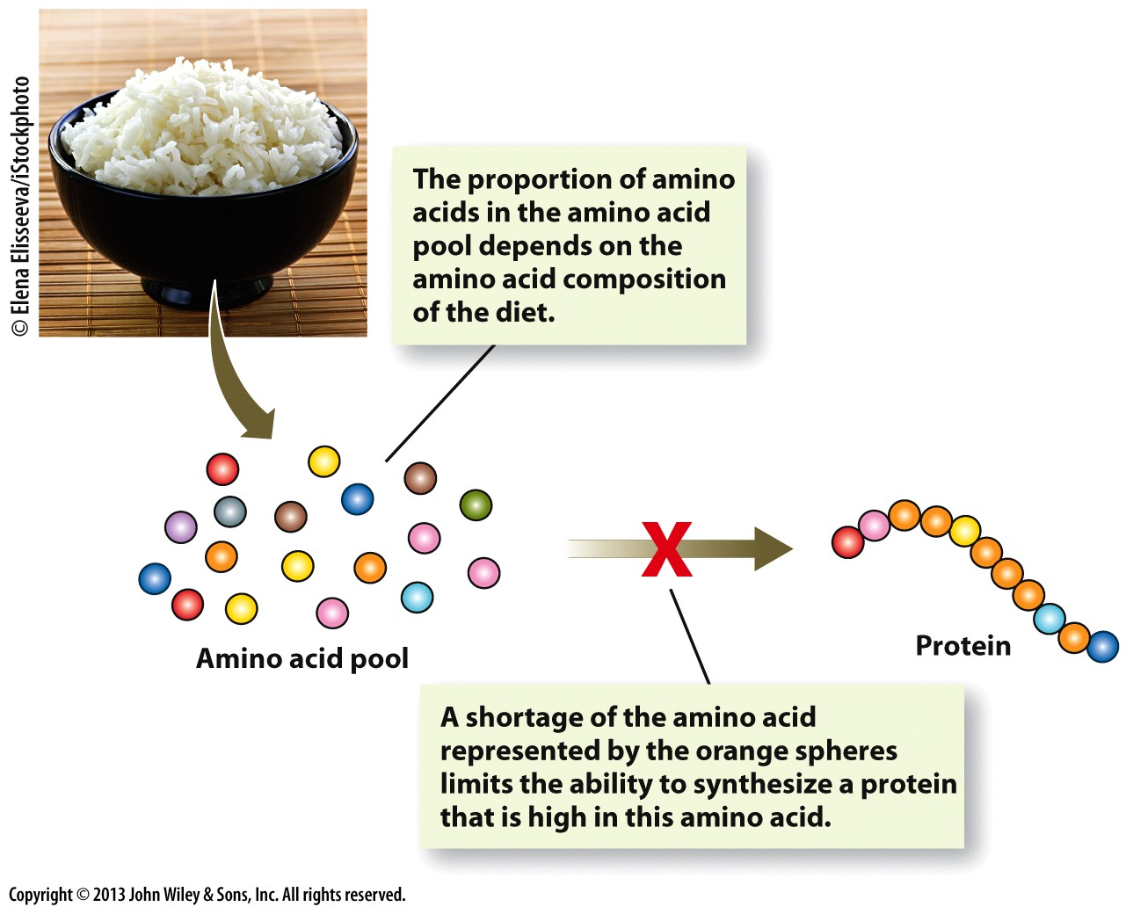
Limiting Amino Acids

Slide 22
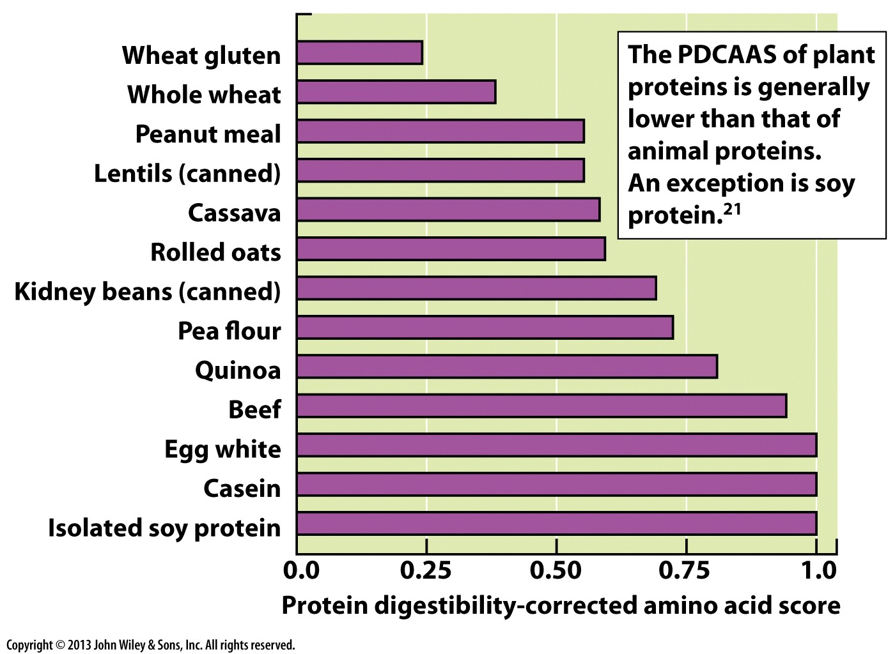
Considering Protein Quality
Notes:
22

Slide 23
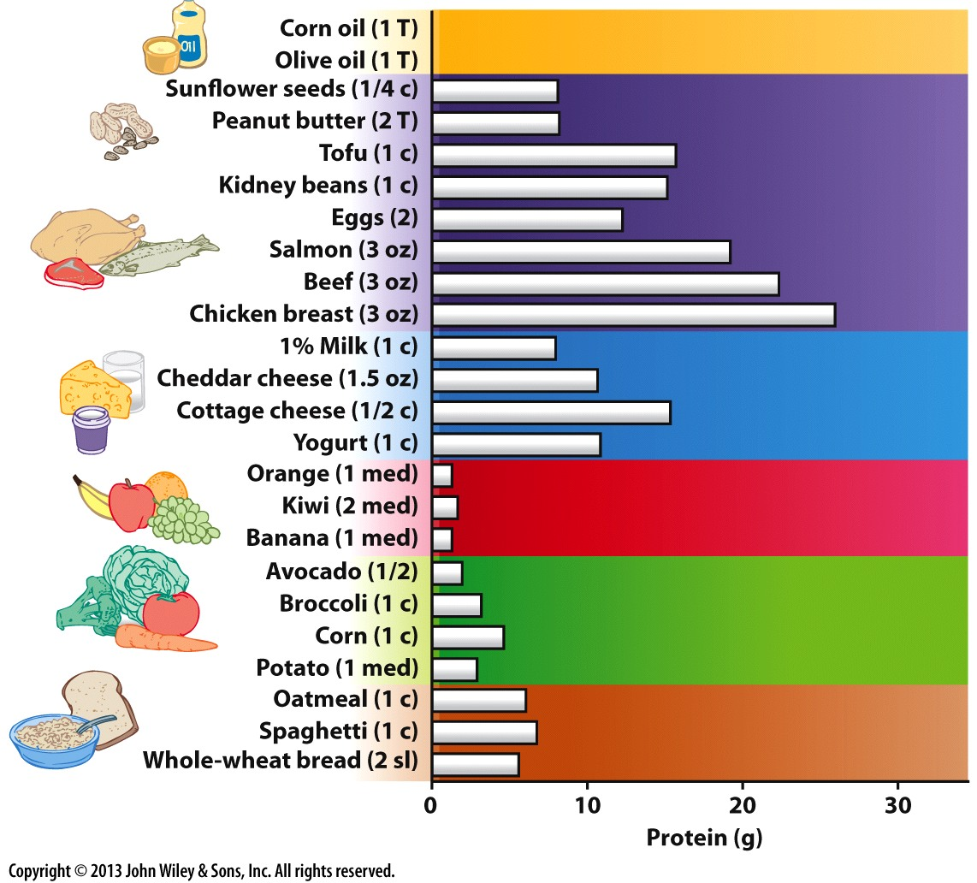
Sources of Protein in the Diet

Slide 24
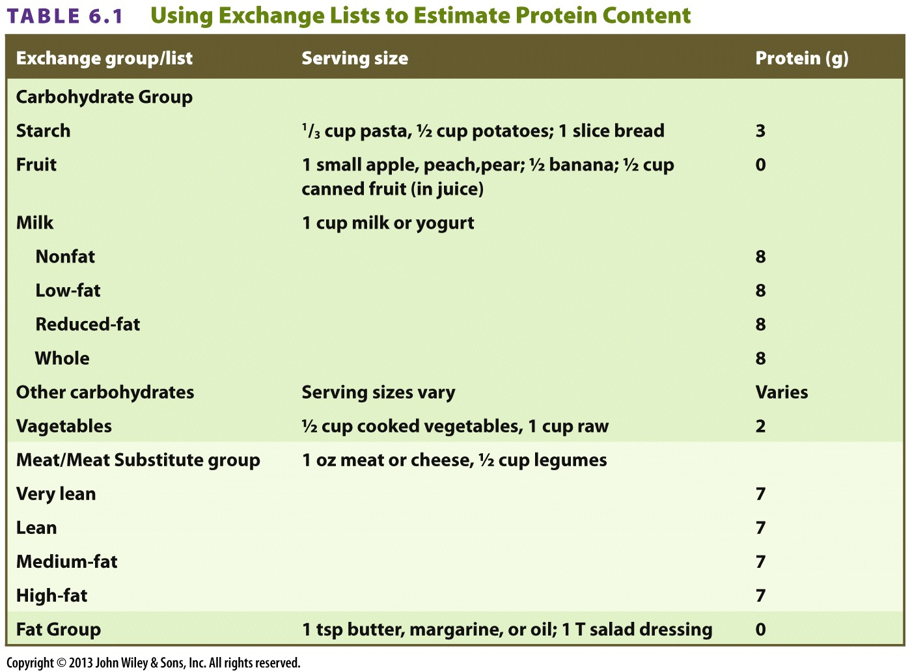
Calculating Protein Requirements
Notes:
24

Slide 25
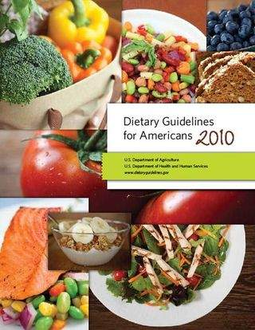
2010 Dietary Guidelines for Americans
Balancing Calories
  Enjoy your food, but eat less
  Avoid oversized portions
Foods to Increase
  Make half your plate fruits and vegetables
  Switch to fat-free or low-fat milk
Foods to Reduce
  Compare sodium in foods and choose foods with lower numbers
  Drink water instead of sugary drinks

Slide 26
2015 DGAC – Food and nutrient intakes, and health: Current status and trends
The US population has low intakes of certain key nutrients – vitamin D, potassium, fiber, calcium, and for females also iron. These low intakes are a public health concern because inadequate intakes are linked to health problems
The US population over consumes sodium and saturated fat. Excess intakes of these nutrients are also linked to health problems
Many of the food groups that are good sources of under consumed nutrients are consumed in low amounts by the US population
Many of the food groups and food categories that have high levels of sodium, saturated fat, and added sugars are consumed in high amounts

Slide 27
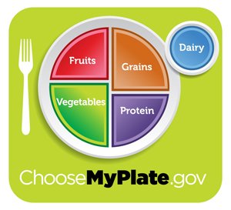
Conclusions
Eat and enjoy a variety of beans, pulses, and legumes as they fit as either vegetables or protein on MyPlate.

