Slide 1


Population, Public Health, Pulses, and Partnerships
Sonny Ramaswamy
New York Academy of Sciences: Little Beans, Big Opportunities

Slide 2
Nutritional Security
An Existential Threat

Slide 3
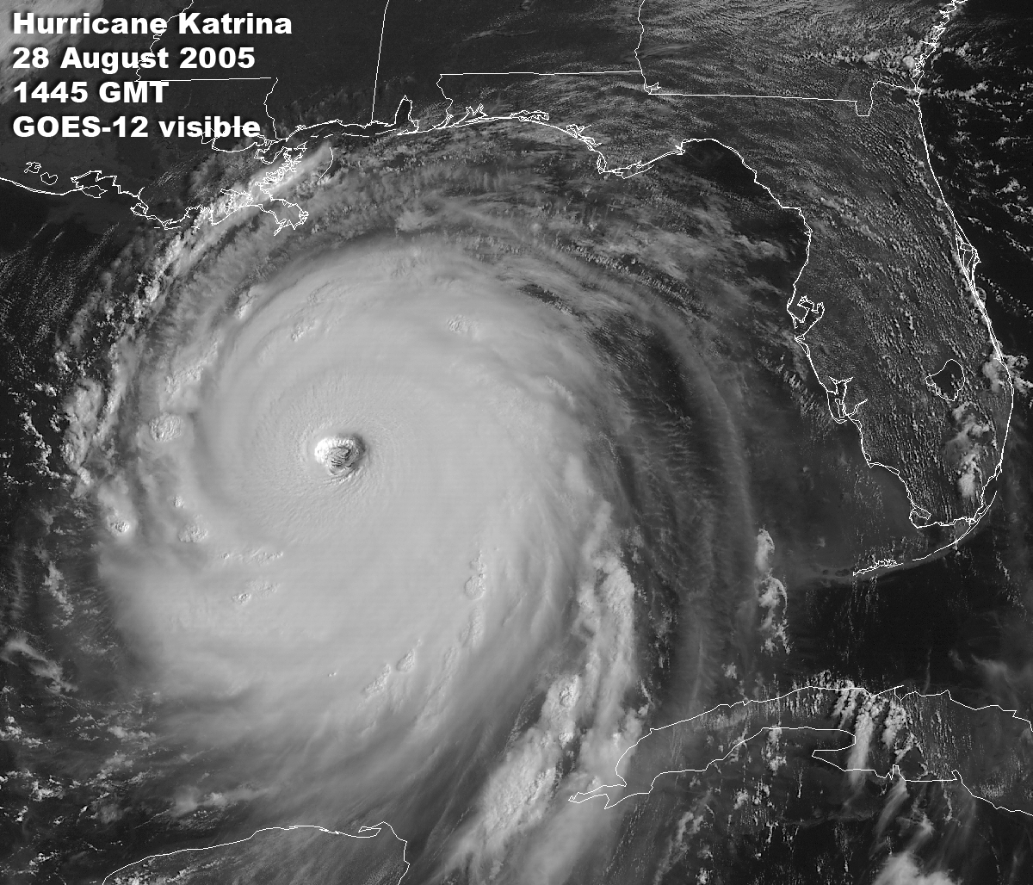

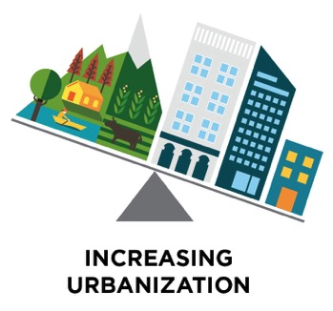
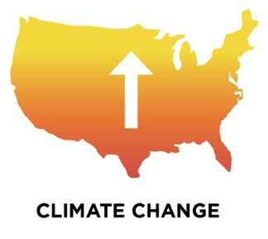
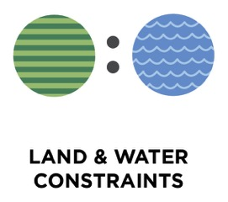



Perfect Storm
http://rsd.gsfc.nasa.gov/goes/pub/goes/050828.katrina.gif
Science

Slide 4
21st Century Food System Challenges
Agricultural Competitiveness
  Improve crop and animal agriculture; enhance farm productivity and income; policies; supply chain; storage; transportation
Ecological Footprint
  Water/land use, natural resource and environmental stewardship, greenhouse gas, global climate change, depleted soils
Bioeconomy
  Replacements for petroleum-based products and enhance community economic well being
Health
  Food safety, (micro)nutrition, obesity, type II diabetes, cardiovascular disease, dementia, cancer, hunger, poverty
Notes:
Protein-energy malnutrition: deficient in calories and protein, most lethal form of malnutrition
“Hidden hunger”: micronutrient malnutrition, affects more than half of the world’s population
>50% of children throughout the world suffer micronutrient deficiency of some form (worldwide)
2 billion people affected, globally
Depending on which micronutrient is deficient, can result in fatigue, impaired motor and cognitive development, and hinder immune function (among other problems)

Slide 5
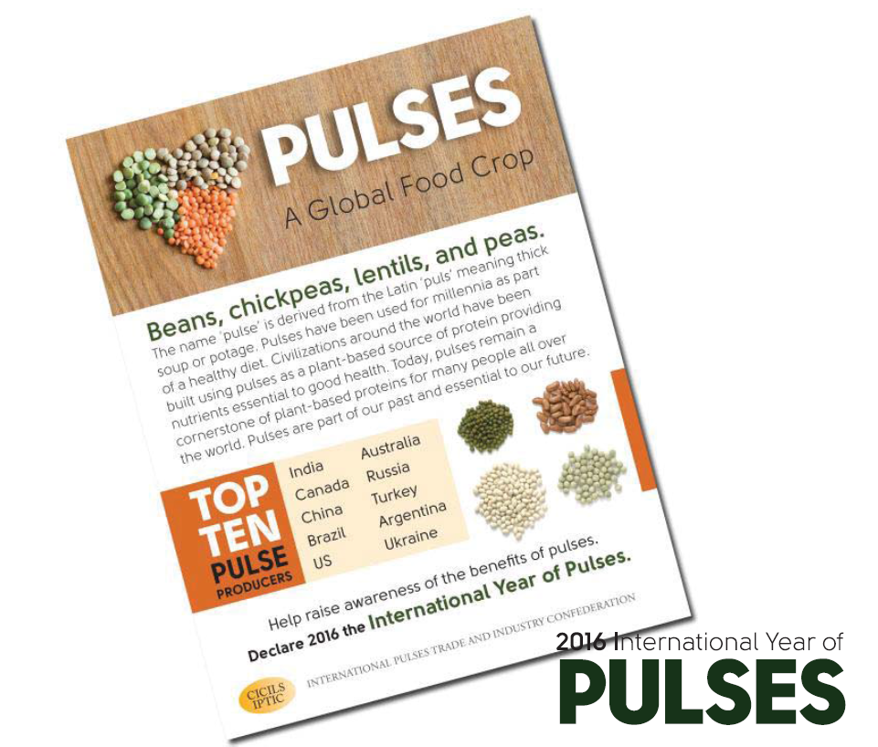
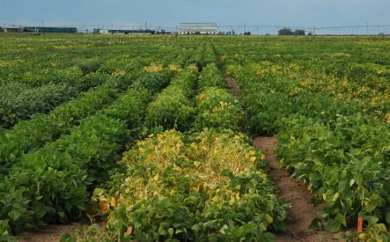
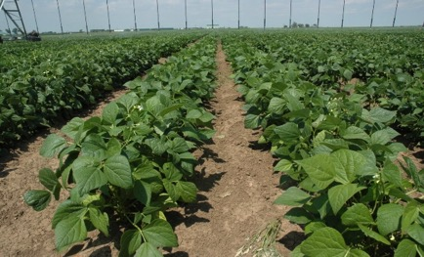
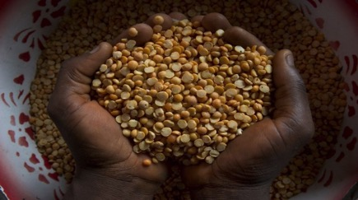
Adapted from Dr. Mark Brick, Colorado State University
Notes:
Pulses are an increasingly popular part of the solution
Grown throughout the US and quite popular in developing nation
Very easy to grow, due to nitrogen fixing capabilities in the rhizosphere
Nitrogen fixing capabilities also make it useful in crop rotation (grain crops benefit from the nitrogen fixation)

Slide 6
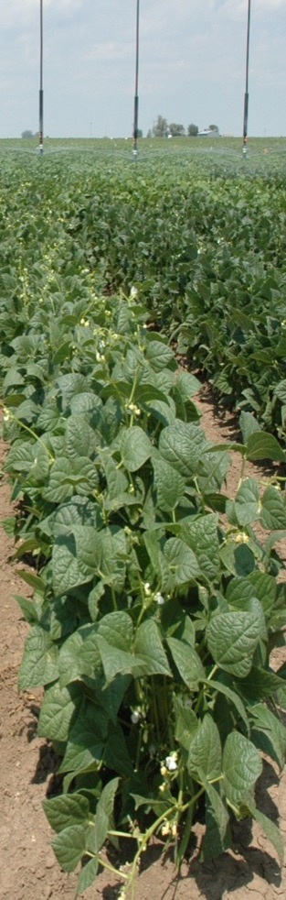

Health benefits of pulse crops
Contain large amounts of vitamins and minerals per calorie
- Key minerals:
Iron, potassium, magnesium, and zinc
- Abundant in B vitamins:
folate, thiamin, niacin
High in protein, essential amino acids
Rich in complex carbohydrates
High in fiber
Healthy microbiome
Adapted from Dr. Mark Brick, Colorado State University
Notes:
High in protein (2x the amount found in whole grain cereals) and also a great source of essential amino acids
Rich in complex carbohydrates that break down slowly (i.e., they have a low glycemic index, which is good for diabetics)

Slide 7
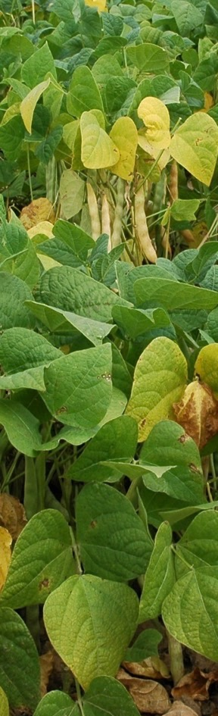
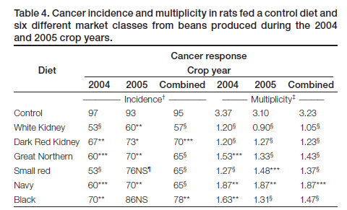
Some Long Term Health Benefits of Pulse Crops in the Human Diet
Bean in infant diet for:
  Growth and development
Bean in adult diet can reduce risks for:
  Cancer (colon and mammary)
  Type 2 Diabetes
  Obesity
  Heart disease
Adapted from Dr. Mark Brick, Colorado State University

Slide 8
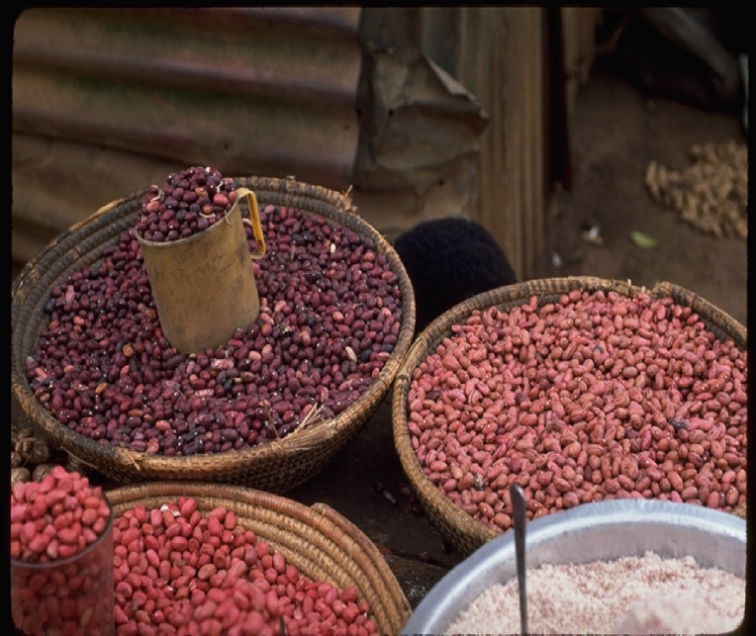
Biofortification of Iron and Zinc in Bean
71 percent of children under 5 and 53 percent of women in Africa are iron deficient
Adapted from Dr. Mark Brick, Colorado State University

Slide 9
Does biofortified = bioavailable?
Use of biomarkers to track nutrient absorption, understand relationship between food consumption and health-related claims
Notes:
But -- Need to make sure that these nutrients are actually bioavailable
Bioavailable = able to be absorbed and used by the body
Bioavailability is governed by both extrinsic (food content) and intrinsic (gender and age) factors
Bioavailability of macronutrients (carbs, proteins, fats) is typically high (> 90% of the amount ingested)
Bioavailability of micronutrients (vitamins and minerals) and bioactive phytochemicals (flavonoids, carotenoids) is quite variable
Can use biomarkers to assess this
Biomarkers: molecules found in the blood, urine, stool that are indicative that certain nutrients have been absorbed by the body

Slide 10
Path forward: A focus on pulses
Knowledge Gaps:
  Role of nutrition and nutrients in health
  Identification of full micronutrient profile in pulse crops
  Allergens and toxic proteins
Questions:
Are biomarkers available for each nutrient of interest?
Can personalized health claims be tailored to each individual’s genetic make-up and medical condition?
How to deal with desirable and undesirable traits?
Notes:
Still need to identify the full micronutrient profile and gain a better grasp of the metabolomics of various pulse crops
Are there’re biomarkers available for each nutrient of interest?
Can we develop personalized health claims based an individual’s genetic make-up or medical condition?
How do we ensure that biomarker measurements are comparable across different lab settings?
What is the role of public-private partnerships in using validated biomarkers and supporting research?
**Not sure if you want to tie in issues related to reports of pulse allergenicity being on the rise: need to ID highly allergenic pulses, develop tools to identify pulse-ingredient allergens in foods, and develop processing and breeding methodologies to reduce pulse allergenicity

Slide 11
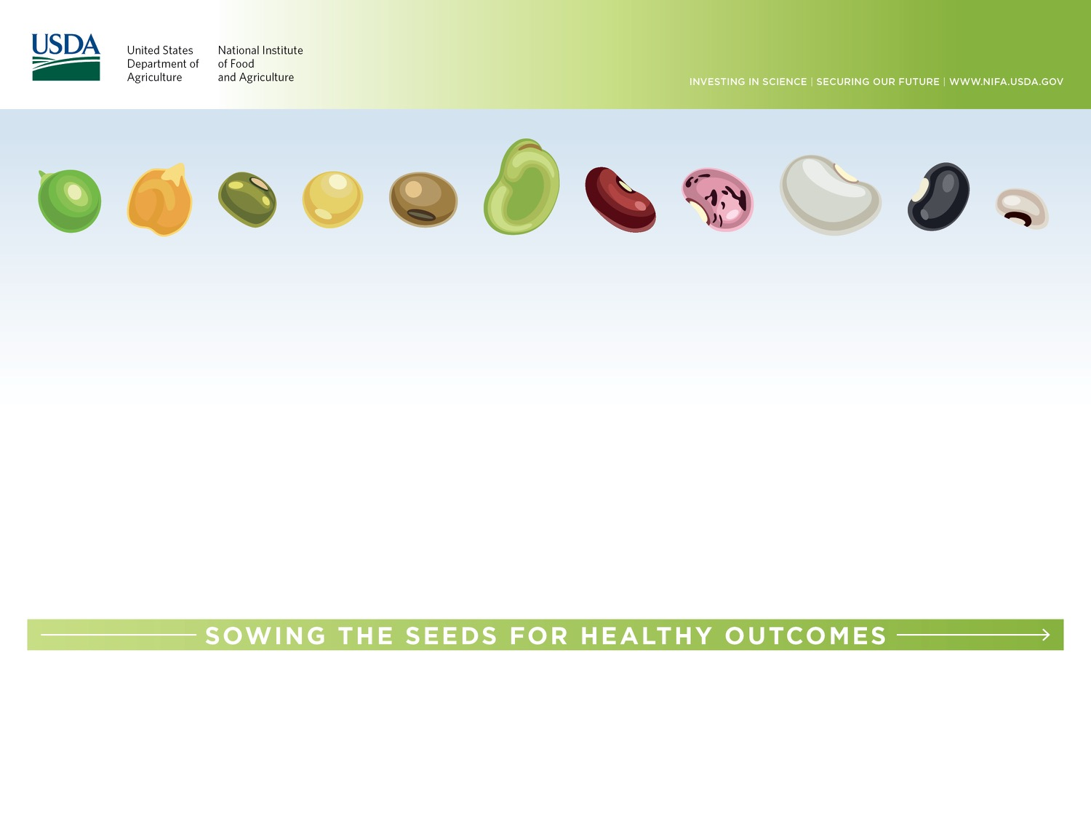
How do we use genetic and genomic tools to develop better crops to promote healthier lives?
Notes:
Connectivity between consuming pulses that will result in better health outcomes – how do we get there??

Slide 12
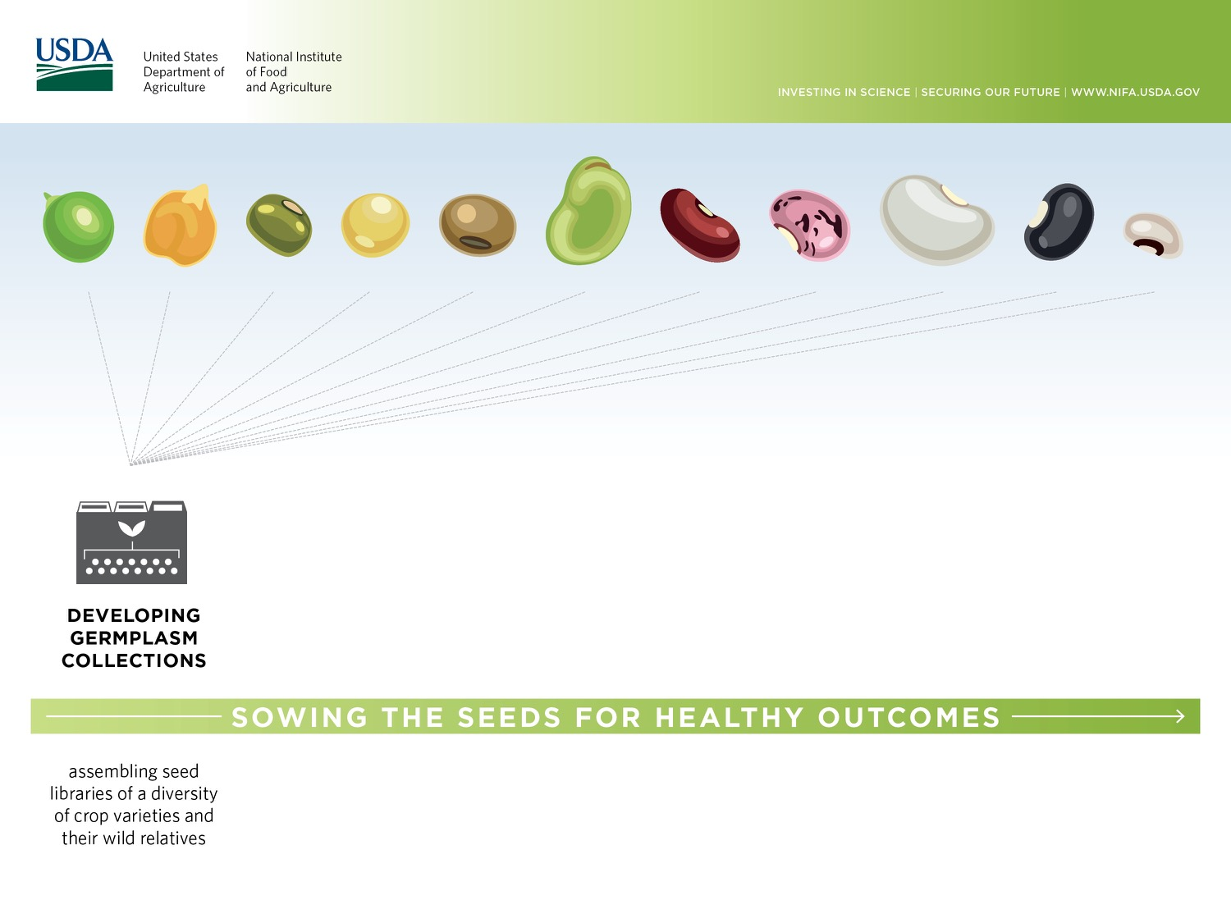
Goal: Capture existing diversity found in nature and in pulses from early cultivation efforts, gathering lineages that are adapted to grow in a variety of environments and contain desirable protein, vitamins, and minerals
The International Center for Tropical Agriculture (CIAT) in Colombia houses the world’s largest and most diverse bean collection
Notes:
Goal: gather existing diversity from nature, early breeding (landraces) – add bit about local adaptation
CIAT is part of CGIAR in Colombia
Much of the germplasm housed at CIAT originates from the primary centers of origin in the Neotropics (e.g., Mexico, Peru, Colombia, Guatemala)
>1900 wild materials + >35,000 cultivated Phaseolus species

Slide 13
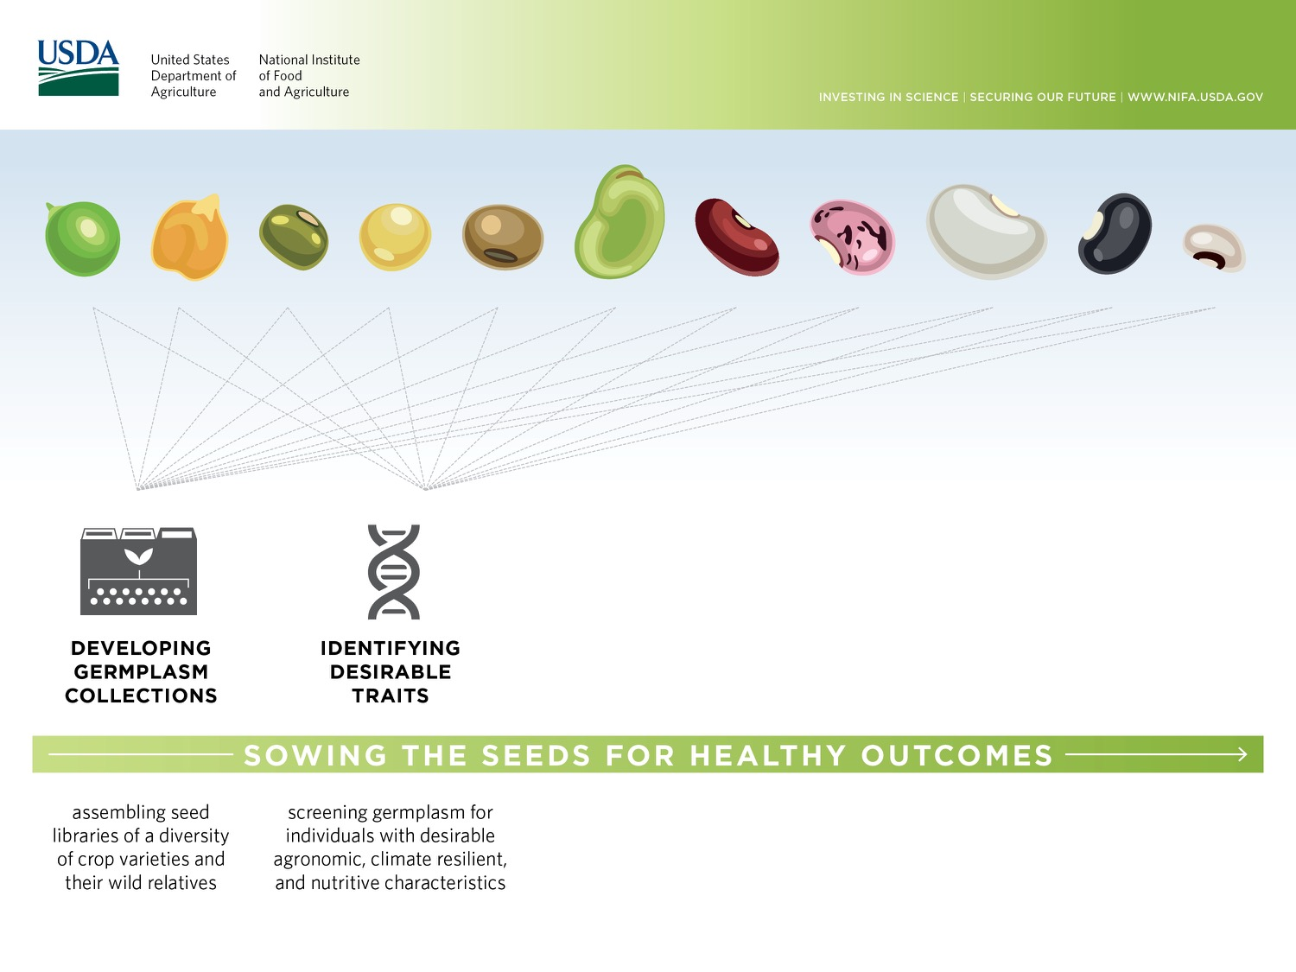
In addition to breeding high yielding crops, need to develop disease resistant and climate resilient varieties
Identify varieties that are rich in desirable micronutrients is key
Identifying the genes that influence these traits will aid in developing genetic assays that accelerate screening and breeding process
Notes:
Develop genetic screens – understanding the relationship between genotype and phenotype so that we can quickly screen using molecular methods (marker assisted selection, genomic selection)

Slide 14
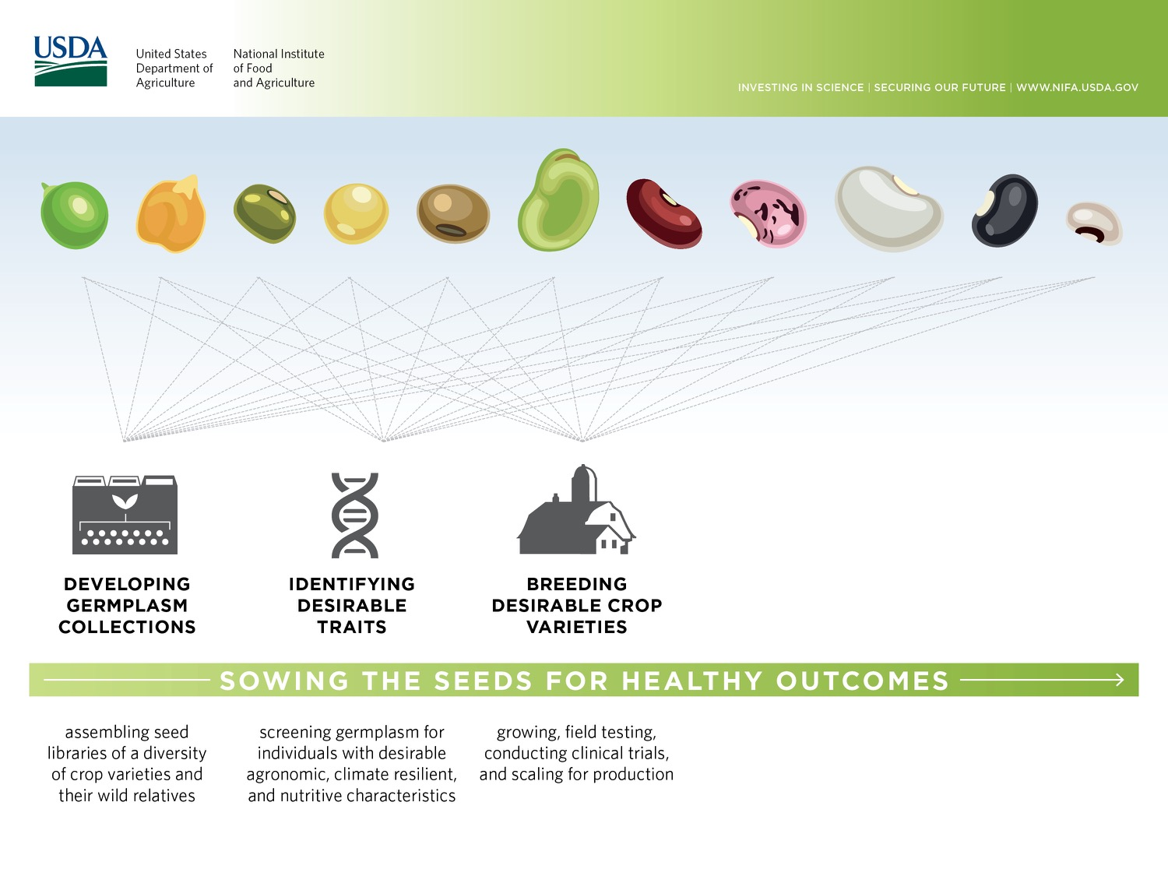
Crossing, growing, and selecting varieties with desired combination of traits
Elimination of undesirable traits
Needs to be targeted to specific growing environments, populations of consumers
Clinical trials to assess micronutrient retention and bioavailability
Accelerate this process via targeted genome editing in crops?
Notes:
Multiple years of breeding (crossing, growing, selecting) to make the optimal crops designed for targeted environments, populations of people
Note: can speed this process through the use of new technologies
Here, need to incorporate clinical studies to address whether crops with altered nutritive content actually have those nutrients bioavailable (biomarkers are important here, testing for uptake)
In the future: use genomic modification (CRISPR/CAS9) to knock-in genes for biofortification (example: may want to knock-out to reduce/eliminate expression of phytic acid, which inhibits Fe and Zn bioavailability and also toxic proteins)
Lots of crossing of promising lines into otherwise favorable genetic backgrounds for many generations
Need for evaluating consumer acceptance (taste, look, and cooking quality)
Then, test micronutrient retention, then micronutrient bioavailability
If promising, then performance of new variety is looked at in an efficacy trial in humans (typically implemented as a follow-up study to an absorption study) – typically, focused on target population – does implementation of the crop into the diet produce the expected results? – study carefully controlled
If that’s promising, then impact on human health status considered in an effectiveness trial, which then mimics reality – broadly defined population (but still representative of targeted audience); food eaten in traditional ways w/in usual household environment – can potentially reveal lack of proper implementation or weak acceptance

Slide 15
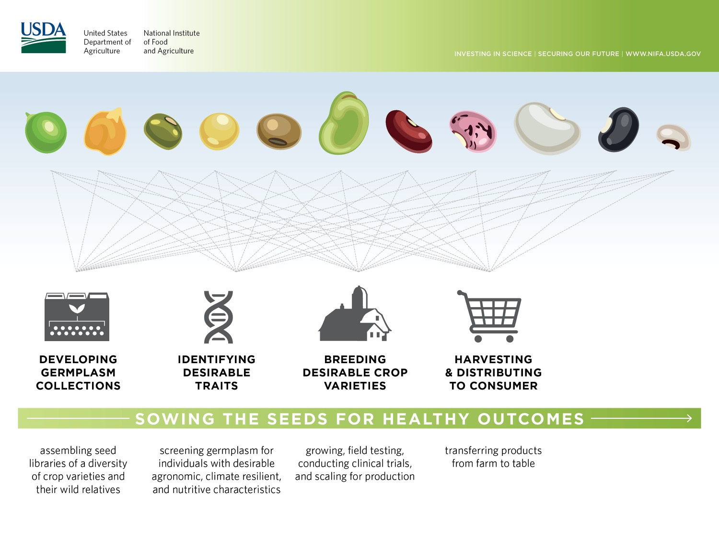
Develop strategies that minimize food waste
Notes:
Via markets, or directly from the lands of smallholder farmers to their tables
Need to minimize food waste

Slide 16
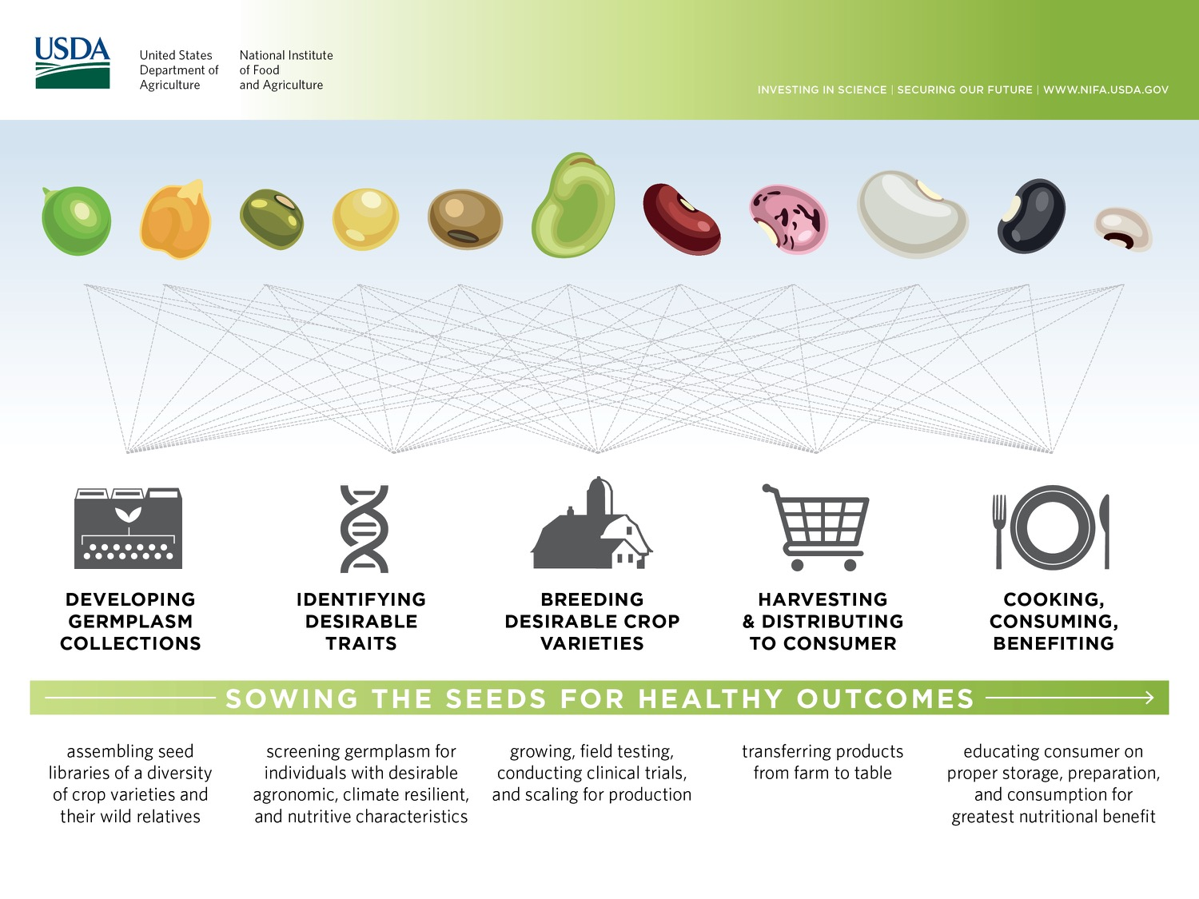
Successful pipeline must be carried out in partnership with the end-user and use transdisciplinary approaches in collaborations across academia, government, and the private sector

Slide 17
Opportunities
Agriculture and Food Research Initiative
Specialty Crops Research Initiative
Organic Agriculture Research and Extension Initiative
Interagency
  NIH
  NSF
  USAID-PEER
  BARD
  BBSRC
  Ireland and Northern Ireland

Slide 18
NIFA/NIH joint initiative:
“Food specific molecular profiles and dietary biomarkers of dietary consumption”
Colorado State University
  Address metabolite profiles in dry beans
Goals
  Discover and validate molecular signatures of dietary intake and long-term food consumption
  Develop a database of food-specific molecular signatures
  Inform policy and disseminate findings to industry
Other NIFA investments
  BeanCAP, Hatch projects to support pulse research
Notes:
More about joint initiative:
partnership between NIFA and National Institute of Diabetes and Digestive and Kidney Diseases
$1.6 M awarded to Dr. Elizabeth Ryan’s research team at Colorado State University
“Rice Bran and Bean Metabolomes for Human Dietary Exposure Biomarkers”
CommonBeanCAP: Award total $4 million, 2009-2014
A few examples of Hatch investments in pulses:
“Reduction of major health problems through pulse consumption” (Michigan State University)
“Genetic improvement of pulse crops for the northern plains” (North Dakota State University)
“Genetic Improvement of pulse crops (pea, lentil and chickpea) for the northern plains” (North Dakota State University)

Slide 19


Opportunities: Precision Foods
Individual genome, epigenome, microbiome
Plant/animal genome, epigenome, microbiome
Wearable sensors
  FitBit, Apple Watch
  Athos, Hexoskin, Gymi
  Google contact lens
Food analysis
Lifestyle
Behavior

