Slide 1
Common beans and cowpeas for gut health in sub-Saharan Africa
Mark Manary MD
Washington University
The presenter has no conflicts of interest to declare

Slide 2
Gut Health
Ability of the gut to absorb all the necessary nutrients in adequate quantities
Provide an effective barrier against a large population of microbes in a diversity of environs
Mount an appropriate immunological response when microbial incursion occurs – vigorous enough to prevent infection, controlled enough to prevent chronic inflammation

Slide 3
The gut is the interactive external body surface
The surface area of the gut is 40 m²
Its purpose is to interact with the nutrients, non-nutrients and microbes
The gut needs to differentiate between food and germs.
The gut surface is protected by mucous and a rich variety of immunologically active cells

Slide 4
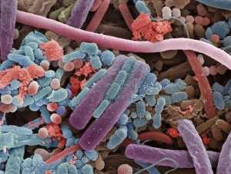
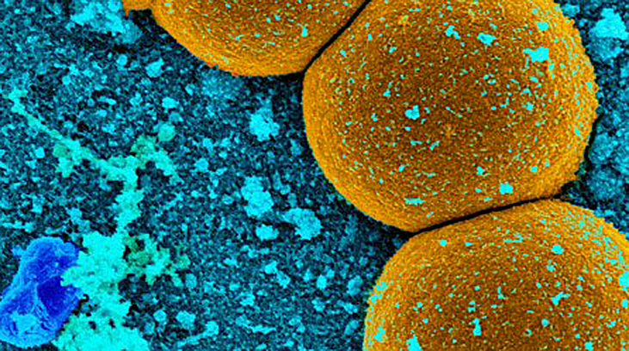
The Microbiota
The ecological community of commensal, symbiotic, and pathogenic microorganisms within our bodies
Human gut has 100 trillion micro-organisms; 100-fold more genes than the human genome
  Anaerobic bacteria
  Archaea
  Yeast
  Parasites
Individual “finger-print” specificity – each person has a unique profile of organisms regulating their microbiome
Complex and dynamic – it is constantly evolving and changing based on exposure

Slide 5
Role of the Microbiome
  Gut microbiota influence the growth and differentiation of gut epithelial cells and play pivotal nutritive, metabolic, immunological and protective functions.
  Efficient extraction of calories from ingested food
    Fermentation of non-digestible polysaccharides
    Provision of short-chain fatty acids
  Enzymatic reactions of the microbiome aid in
    Host homeostasis
    Food digestion, absorption
    Synthesis of micronutrients - Vitamins K, multiple B vitamins, H₂, CO₂, Methane, Lysine, Conversion of Urea to Ammonia
  Detoxification
    Modulates enterohepatic circ of compounds detoxified by the liver
  Epithelial development
  Immune function
    Stimulates the growth of enterocytes
    Commensal organisms protect from pathogens

Slide 6
Core Microbiota
All healthy adults share most of the same gut bacterial species
Vast microbial diversity that is highly variable over time and across populations
  Over 7000 distinct phylotypes have been detected in the human distal gut
Adult Taxonomic Divisions
  Bacteroidetes –fat and protein digestion
  Firmicutes
  Minor: Actinobacteria, Proteobacteroa and Verrucomicrobia
  Methanogenic archaea, eukaryotes, viruses
Proportions of micro-organisms vary person-to-person

Slide 7
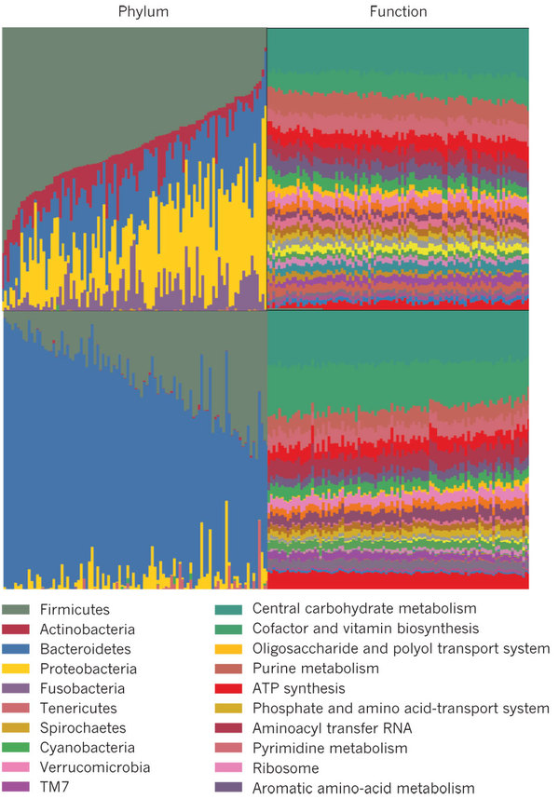
Functionality of the Core Microbiome
The activity and composition of the microbiota is affected by genetic background, age, diet, and health status of the host
Understanding function
  Ex-vivo phenotype experimentation
  DNA
  Active mRNA, protein and metabolite profiles
Central, carbohydrate and amino-acid metabolism

Slide 8
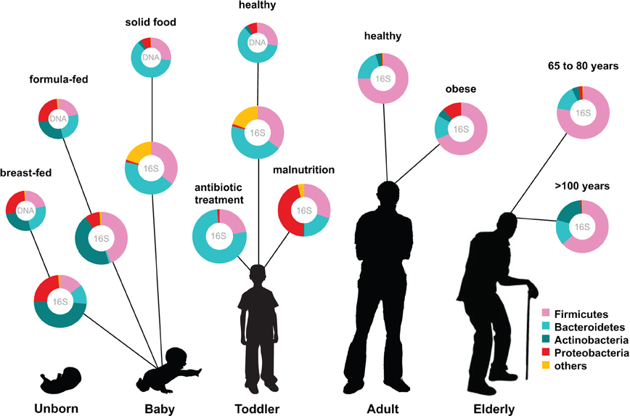
During life the microbial composition increases in both diversity and richness and reaches highest complexity in the human adult, with several hundred species-level phylotypes dominated by the phyla Bacteroidetes and Firmicutes
Ottman et al. Frontiers in Cellular and Infection Microbiology, 2012.

Slide 9
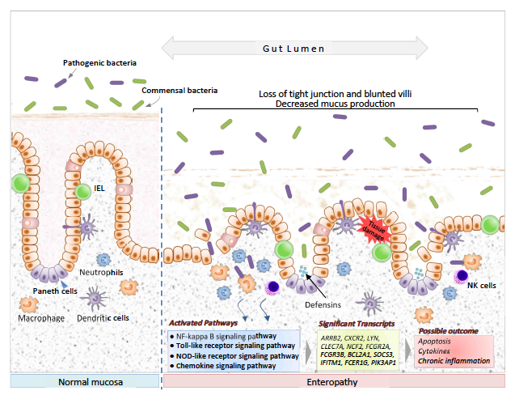
Barrier function of the gut

Slide 10
Poor gut health and nutrient absorption
Children with significant gut health have reduced absorption of fat (≈5%), vitamin B₁₂
carbohydrates (≈5%), and protein (≈15%)
Overall wastage of >5-10% of nutrients
Int Health 2010; 2: 172

Slide 11
Poor gut health is caused by a poor diet and a contaminated environment
Environmental enteropathy is uncommon in environs with modern sanitation
Animal models of enteropathy can be seen in micronutrient deficient or malnourished states

Slide 12
Consequences of poor gut health
Stunting: Failing to develop as a young child such that physical stature, cognition and immune competence are forever compromised. This affects about 25% of all children worldwide and accounts for 21% of all health morbidity worldwide. Africa is the continent most affected by stunting
In the developed world poor gut health is associated with increased risk colon cancer and inflammatory bowel disease.

Slide 13
Nutrient content of common beans and cowpeas
Protein in legumes: 4x the density of cereals. Cowpea is 23-32% protein. Common bean is 21-25% protein.
Legumes are rich in folic acid, riboflavin, iron and vitamin B₆.
Aside from protein and folic acid, they are not more nutrient rich than cereals.

Slide 14
Legume food matrix highly digestible
Nutrients from cooked common bean and cowpea are bioavailable.
Protein is 84-94% absorbed from common bean and cowpea.
Food matrix easily disrupted with simple boiling.

Slide 15
Prebiotics in bean and cowpea
Both are legumes rich in resistant starch, fructooligosaccharides, stachyose, raffinose, fiber that feeds commensal bacteria.

Slide 16
Anti-Inflammatory Effects of Beans
Swedish brown beans decrease IL-6 and IL-18 in humans
Non-digestible portion of common beans down-regulates signaling pathways that lead to inflammation in a mouse model of colon cancer
When fermented by normal gut flora, the non-digestible fraction from common beans produces short-chain fatty acids that inhibit colon cancer HT-29 cell growth
Non-digestible fraction of common beans protects against chemically-induced crypt inflammation in rat colons
PLoS ONE 2013; 8: e59985
Br J Nutr 2012; 108S1: S145
J Agr Food Chem 2012; 60: 12443
Food Funct 2010; 1: 294
J Agr Food Chem 2008; 56: 8737

Slide 17
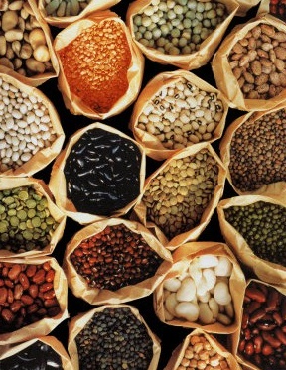
Why feed Legumes?
Prior interventions against EE have shown marginal benefits, at best.
Diets enriched in legumes decrease markers of inflammation
  Increased legume intake inversely correlated with illnesses with inflammatory components such as colorectal cancer and cardiovascular disease
May serve as a major source of protein in populations where carbohydrate consumption predominates in complementary feeding
J Nutr 2012; 142: 334
Nitric Oxide 1997; 1: 476
Lipids 2010; 45: 765
Eur J Clin Nutr 2011; 65: 415
Dry Beans and Pulses 2012
JPGN 2007; 44: 487

Slide 18
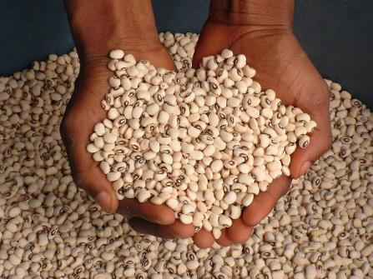
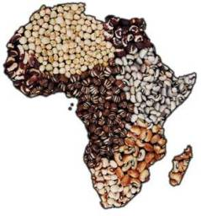
The Potential of Cowpeas
Grows well in Africa, is culturally accepted, and is a hardy, drought-tolerant crop
Anti-inflammatory effects mediated by specific phenolic profiles and antioxidant activity
Phenolic compounds are also active following cooking and simulated enzymatic digestion
Soil and Crop Sciences 2012
Int J Food Sci Tech 2013; 48: 2638

Slide 19
Legumes and Growth Study design
Type of study: Two parallel randomized, double-blinded, prospective clinical trials
Problem to be studied: Environmental enteropathy (EE) and stunting in children
Objective: Evaluate the effectiveness of two different legume foods (cowpeas and common beans) in maintaining and/or restoring normal gut absorptive and immunological function in rural Malawian children at high risk for EE and stunting during their first three years of life

Slide 20
Methods
Two methodologically similar prospective randomized, investigator-blinded prospective clinical trials will be used
First trial
300 healthy children aged 6-11 mos will be randomized to receive:
Infants will be recruited between the ages of 5.5 and 6.5 months, and their participation will last for approximately 6 months
The energy content of the complementary foods provided will be in accordance with WHO specifications, namely 100 kcal/day for children 6-9 months old and 150 kcal/day for children 9-11 months old
legume-based complementary food made from cowpeas
legume-based complementary food made common beans
isoenergentic amount of corn flour with 10% soy

Slide 21
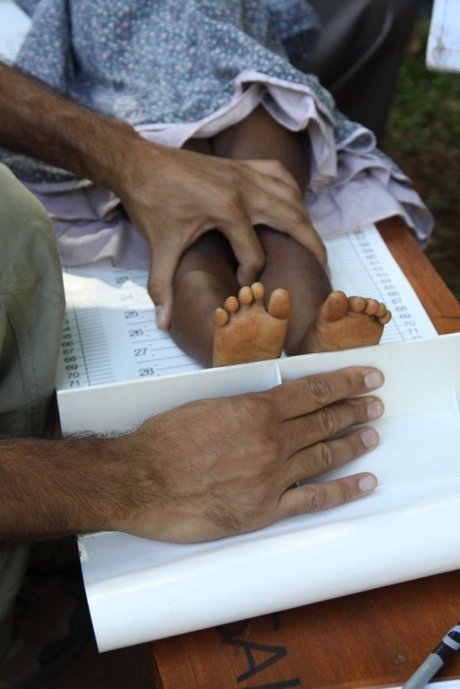
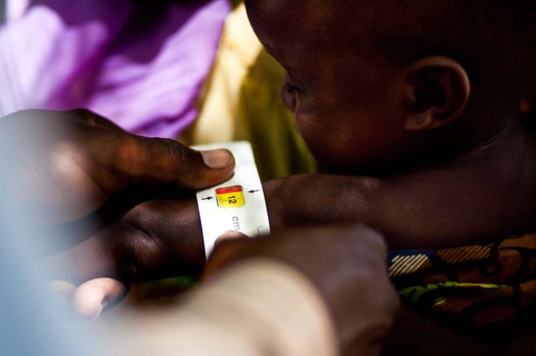
Methods
Before the complementary foods are given, the children will participate in a dual sugar permeability test and give stool samples for additional biomarker tests to measure gut function and also to evaluate the evolution of the enteric microbiome
The dual sugar permeability test (the lactulose-mannitol test) involves drinking 20 mL of a sugar water solution and collecting urine for 4 hours thereafter
Dietary intake will be assessed every 6 weeks.
Children will return 12 and 24 wks after starting the intervention for assessments, including the dual sugar absorption test, stool collection, and anthropometry

Slide 22
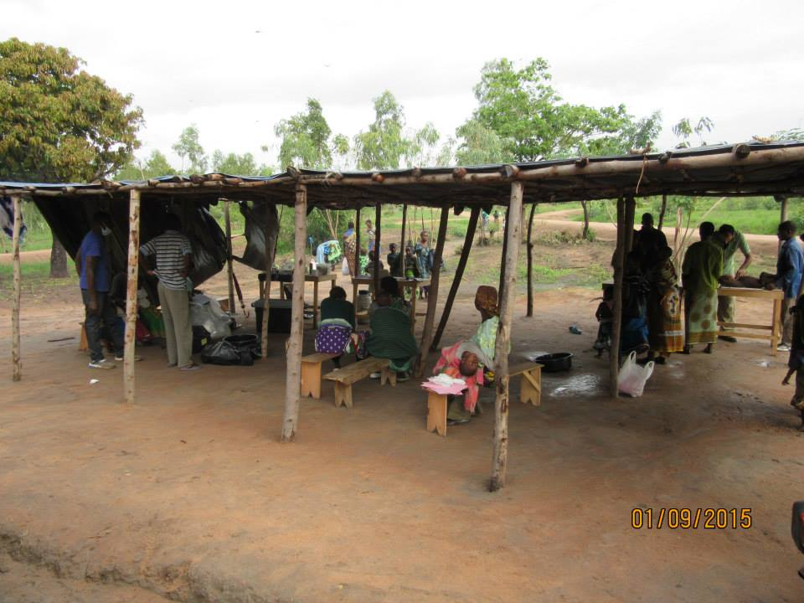
Methods
Toddler trial
  300 healthy children aged 12-23 months will be randomized to receive cowpea, common bean or corn daily for 12 mo.
  Anthropometry, assessments of EE, and microbiome analyses will proceed in a very similar manner and be repeated after 12, 24, 36, and 48 weeks
Energy content of the complementary foods provided will be approximately 15% of the calculated total daily intake

Slide 23
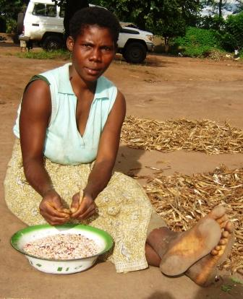

Food Intervention
Recipes were developed by the research team in conjunction with MSc students in the Department of Food Science and Technology on the Bunda Campus of the Lilongwe University of Agriculture and Natural Resources (LUANAR)
An extrusion cooked, legume powder is added daily to cooked corn porridge. Sprinkled on top of the porridge so to speak. Dispensed monthly in a bottle that can be opened and closed daily.
The materials that will be supplied to mothers will have undergone pre-processed, such that the families need only to add hot water and stir the content to prepare the complementary food
Mothers will be taught how to add legumes to their children’s diets in a manner compatible and feasible with available local resources and customs
Compliance will be assessed through home visits every 4-6 weeks and detection of amylase-resistant starches in the infant’s stools indicative of legume consumption

Slide 24
Outcomes
Primary outcomes:
a standard marker of EE, specifically changes in the urinary lactulose: mannitol ratio (L:M)
2) a standard marker of growth, the change in height-for-age Z-score
Secondary outcomes:
1) adverse gastrointestinal symptoms, as well as changes in the enteric microbiota, enteric microbiome, and a panel of host mRNA in stools.

Slide 25
Expected Findings
Children receiving the legume-based complementary foods will have:
1)improvements in their dual sugar permeability testing over the duration of the supplement compared to placebo
2) changes in their microbiota and microbiome, reductions in their inflammation biomarkers in comparison with the placebo group receiving standard corn-soy flour
3) LESS STUNTING

Slide 26
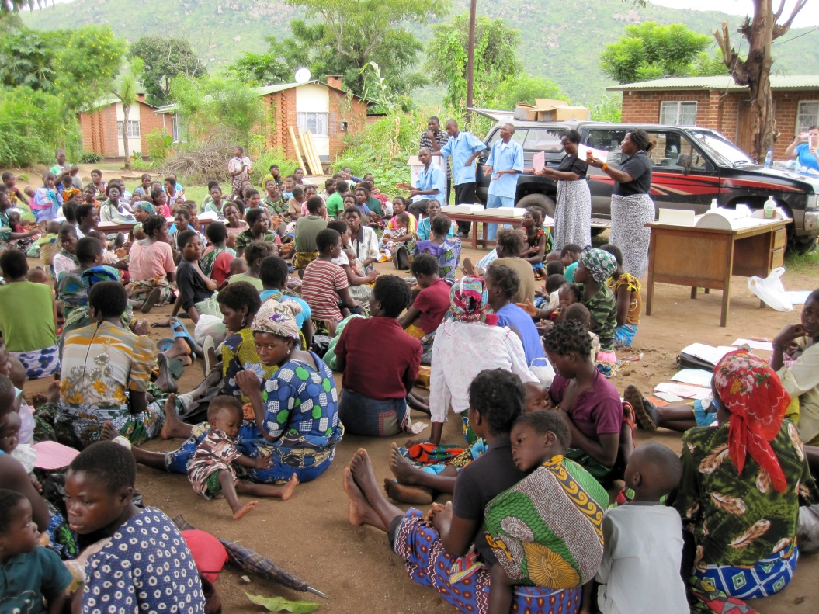


Thank you

