Slide 1
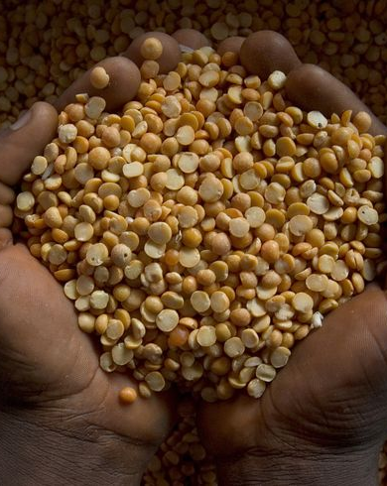


Pulses for nutrition and health
Ruth Charrondiere, Raíssa do Vale, Fernanda Grande, Anna Lartey
Notes:
To replace this picture, just select and delete it. Then use the Insert Picture icon to replace it with one of your own!

Slide 2
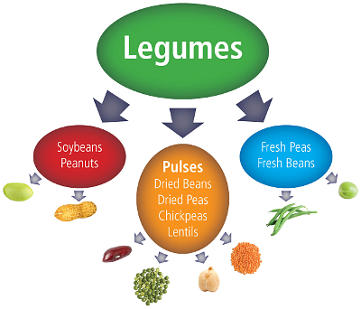
What are pulses?
Annual leguminous crops yielding from one to 12 grains or seeds of variable size, shape and colour within a pod.
Used for both food and feed
The term "pulses" is limited to crops harvested solely for dry grain, thereby excluding crops harvested green for food (green peas, green beans, etc.) which are classified as vegetable crops.
Also excluded are those crops used mainly for oil extraction (e.g. soybean and groundnuts) and leguminous crops (e.g. seeds of clover and alfalfa) that are used exclusively for sowing purposes.
They include bambara beans; beans, dry; broad beans; horse beans, dry; chick peas; cow peas, dry; lentils; lupins; peas, dry; pigeon peas; pulses, nes, and vetches.
Source: Pulse Canada
Source: FAO, 2015. Available on: http://www.fao.org/pulses-2016/en/

Slide 3
Why are they important?
Pulse crops such as lentils, beans, peas and chickpeas are a critical source of plant-based proteins and amino acids for people around the globe, as well as a source of plant-based protein for animals;
World Food Programme and other food aid initiatives use pulses as a critical part of the general food basket;
Pulses play as part of sustainable food production aimed towards food security and nutrition;
Pulses are leguminous plants that have nitrogen-fixing properties which can contribute to increasing soil fertility and have a positive impact on the environment;
Health organizations around the world recommend eating pulses as part of a healthy diet to address obesity, as well as to prevent and help manage chronic diseases such as diabetes, coronary conditions and cancer
Pulses were included as foods to eat more often in Health Canada’s Eating Well with Canada’s Food Guide, the MyPlate system of the United States Department of Agriculture (USDA), the Eatwell Plate of the Food Standards Agency in the UK and Nutrition Australia’s Healthy Living Pyramid
Source: UN, 2014. Available on: http://www.un.org/en/ga/search/view_doc.asp?symbol=A/RES/68/231&Lang=E

Slide 4
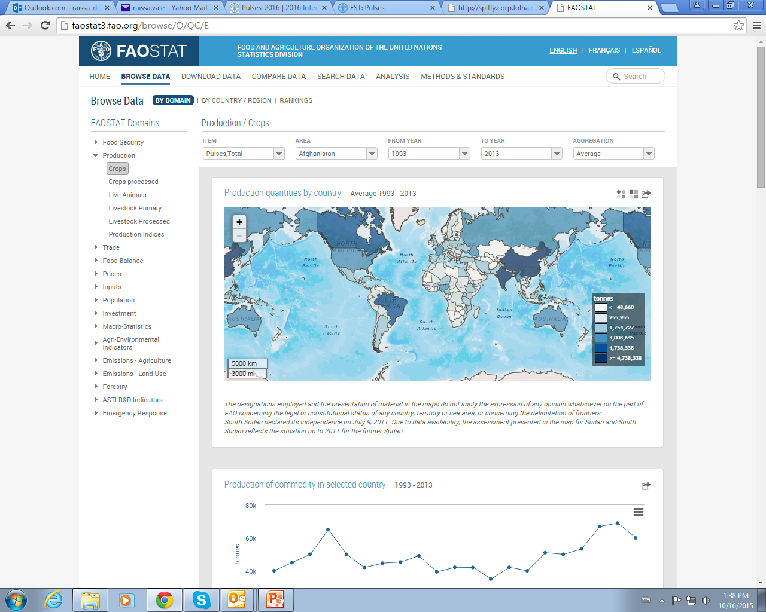
World production
Source: FAOSTAT, 2015

Slide 5
Food supply of pulses – World and Regions
Food supply quantity – pulses (kg/capita/yr)
Source: FAOSTAT, 2015

Slide 6
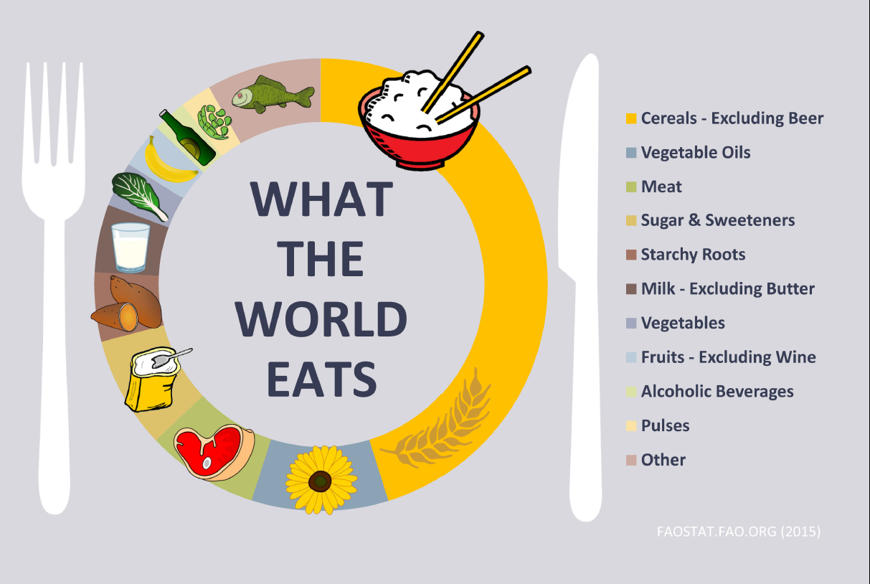

Slide 7
Nutrient profile (per 100g EP)
Pulse | Energy (kcal) kJ | Protein (g) | Fat (g) | CHO (g) | Fiber (g) | Fe (mg) | Zn (mg) | Folate(mcg)
Lentils, dried, raw | (297)1240 | 25.4 | 1.8 | 29.4 | 30.5 | 7.0 | 3.9 | 295
Beans, white, dried | (335)1420 | 22.1 | 1.5 | 47.1 | 16.7 | 5.7 | 3.8 | 395
Cowpea, dried, raw | (316)1340 | 21.2 | 1.3 | 47.2 | 15.3 | 7.3 | 4.6 | 417
Chickpeas, mature seeds, raw | (378)1580 | 20.5 | 6.0 | 62.9 | 12.2 | 4.3 | 2.8 | 557
Beans, pinto, mature seeds, raw | (347)1340 | 21.4 | 1.2 | 62.5 | 15.5 | 5.1 | 2.3 | 525
Bean, carioca, raw | (329)1377 | 20.0 | 1.3 | 61.2 | 18.4 | 8.0 | 2.9 | -
Source: West African Food Composition Table, 2012; USDA, 2014; TACO, 2011.

Slide 8
Importance in human nutrition - Composition
High protein content in their structure and significant importance in terms of nutrition source;
High content of fibre and relatively high amylose starch and antinutrients (phytic acid)
The amino acid composition of pulses are complementary to those of cereals, and if consumed in combination, increase the overall protein quality of the meal;
Low fat content and no cholesterol;
Low glycemic index;
Rich in minerals (iron, magnesium, potassium, phosphorus, zinc) and B-vitamins (thiamin, riboflavin, niacin, B6, and folate).
Campos-Vega et al., 2010; Kalogeropoulos, 2010; Curran, 2012

Slide 9
Importance in human nutrition – Health benefits
Association between consumption of pulses and reduced risk of obesity, diabetes mellitus, cardiovascular disease, components of metabolic syndrome and cancer;
Pulses may help to increase satiety and weight loss (fibres, trypsin inhibitors and lectins may reduce food intake by facilitating and prolonging cholecystokinin secretion)
Fibre and resistant starch of pulses have been shown to alter energy expenditure, substrate trafficking and fat oxidation as well as visceral adipose deposition
The high amounts of insoluble fibre found in pulses has shown to improve colon health, helping to prevent colon-rectal cancer
Phytonutrients, including antioxidants, found in pulses may have anti-cancer properties;
Alekel et al., 2000; Anderson &Major, 2002 ; Smith et al., 2012; Hutchins et al., 2012; Marinangele & Jones, 2012; Dahl et al., 2012

Slide 10
Pulses database
Global pulses database
First step - Collection of analytical data
To be also published on biodiversity database
Second step – User database
Complete user database - 28 nutrients and amino acid profile
Over 22000 articles to be screened for compilation
Two species already evaluated (Mucuna pruriens and Pachyrhizus erosus L.) and to be compiled

